Slide 1
Wimborne Model Town (WMT)
River System Water Sustainability Project
Canford School
Projects Inaugural Meeting
22nd January 2018

Slide 2
Points for Discussion
Introductions / meet the team
Health and Safety
Familiarisation with site and facilities
Introduction to on-line Forum – Working on engineering projects as part of a team.
The development process and expected deliverables.
General Q&A
Detailed Q&A on projects with individuals

Slide 3
INTRODUCTIONS
Wimborne Model Town:
  Greg Hoar – WMT Manager
  Nick Clark – WMT Site Supervisor
  Stuart Laybourne – Trustee (responsible for H&S and maintenenance)
WMT River System Team:
  Penri Jones – Team Leader, Hardware, Planning, Groundwork.
  Terry Coles – Systems, Hardware, Software.
  Hamish McIntyre-Bhatty – Software, Groundwork.
  Clive Wills – Mechanical / Craftwork.

Slide 4
Health and Safety (1)
All Volunteers must be aware of the following key points from the WMT Health and Safety Policy:
  Know the location of the exits from the site and the fire muster point. These areas will be pointed out during the site tour.
  If you discover a fire or a fire alarm is raised then you must move to the muster point. Do not attempt to fight the fire.
  Know the nature of specific hazards in the main work areas on the site.
  If needed, Personal Protective Equipment will be provided and this must be worn as directed.

Slide 5
Health and Safety (2)
Key points continued:
  In the event of an accident, first aid kits and trained first aiders are available. Do not attempt to carry out first aid yourself.
  Do not attempt to lift any heavy or awkward loads without assistance from someone trained in manual handling.
  You may not use any hazardous chemicals unless supervised by a member of staff.
  You may not work on any mains electrical equipment or circuits carrying more than 50 V.
  When working outdoors, precautions must be taken if you are exposed to bright sunshine for prolonged periods.

Slide 6
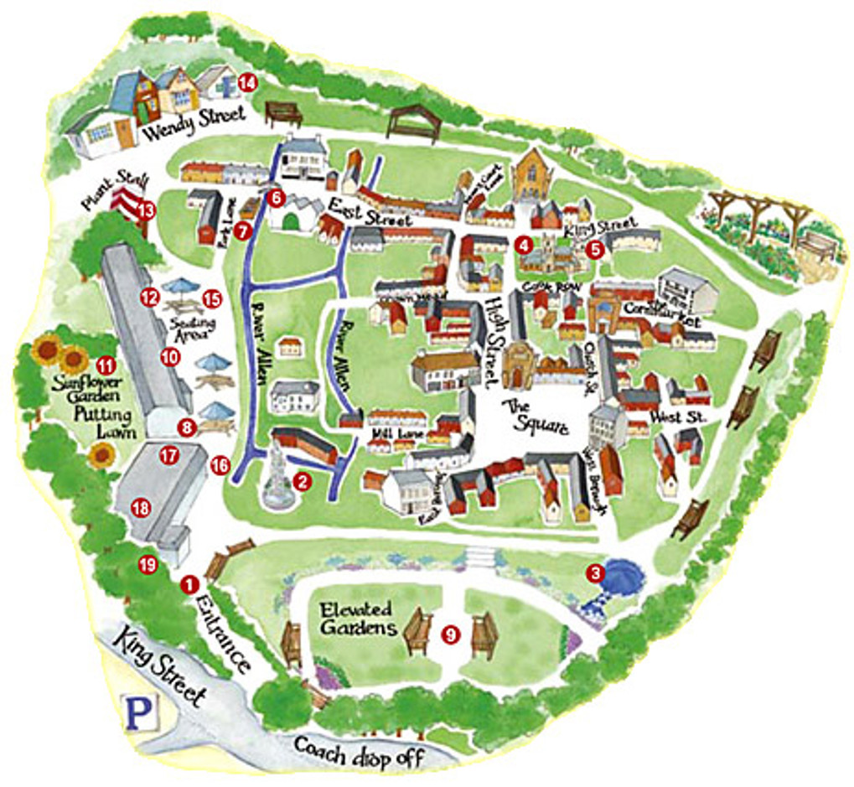
FAMILIARISATION WITH SITE AND FACILITIES
Site Tour
as required

Slide 7
Water Sustainability Project Goals
Save water (money):
  Stop leaks.
  Use less mains water.
  Active water management.
Save the environment:
  Scavenge and store rainwater.
  Cleaner water (less algae, etc).
  No pollution (no chemicals, metals, hydrocarbons, etc).
Education:
  For Visitors (the people who pay to get in).
  For Students (the people from local schools).

Slide 8
INTRODUCTION TO ON-LINE FORUM Access
The Project Teams at WMT maintain an online Forum at wmtprojectsforum.altervista.org/.
This Forum is not just for the River System Project, but has been used extensively for discussion about the work to date.
The Forum may be viewed by anyone, but to post, a login is required. This can be created from the Home Page by clicking on the 'Register' link at the top right of the page.

Slide 9
INTRODUCTION TO ON-LINE FORUM
WORKING ON ENGINEERING PROJECTS AS PART OF A TEAM
The Forum is a very useful tool which aids the development of the work in many ways:
  Primarily, it is a very efficient means of communication. Earlier projects relied heavily on email and face to face discussions, but this has a number of disadvantages.
  The use of a forum helps with teamwork because:
    Team members who become involved later can review the earlier work.
    Topics can be discussed and agreed in some detail before work begins.
    Face to face meetings are much more efficient, because much of the discussion has already happened.
    A written record exists of all points of view and decisions taken.

Slide 10
THE DEVELOPMENT PROCESS
WMT projects use a development process which has been proven in Industry over many years:
  Requirements are written and agreed by the 'Stakeholders'.
  A Design is proposed and accepted .
  The system is implemented and tested using an 'agile' process. This is known as Integration.
  The completed system is presented to the WMT management (who have been pretty involved from the start so problems at this stage are rare).

Slide 11
EXPECTED DELIVERABLES
Deliverables:
  A Design document, that details the solution to the specific Requirements.
  A working version of the solution which might be:
    A software program.
    A piece of hardware.
    A change to the river environment.
  Where applicable, detailed maintenance and repair information.
  A demonstration of the solution in situ.

Slide 12
Questions and Answers
General:
  On any topic relating to the work process or deliverables.
Projects with individuals:
  Split into the various teams.

